Slide 1








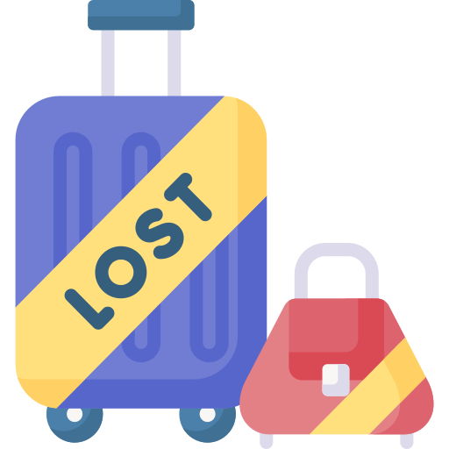


Cluster 0
Avg total spend: 2,806.82 (highest)
Avg purchase consistency: 0.84
Avg ticket size: 15.53
Cluster 1
Avg total spend: 11.38
Avg purchase consistency: 0.02
Avg ticket size: 5.79
Cluster 2
Avg total spend: 59.41
Avg purchase consistency: 0.07
Avg ticket size: 7.63
Star customer
Lifetime
One-timer
Lifetime
Once in a blue moon
Lifetime
Avg total visits: 213.10 (highest)
Avg recency (days): 4.12 (shortest)
Avg MTBP (days): 4.98 (shortest)
Avg total visits: 1.75 (lowest)
Avg recency (days): 612.70
Avg MTBP (days): 67.14
Avg total visits: 7.60
Avg recency (days): 91.28
Avg MTBP (days): 193.66 (longest)
Visits
Visits
Visits
Avg total SKUs: 387.36 (highest)
CV total SKUS: 0.37
Avg total SKUs: 6.08 (lowest)
CV total SKUS: 1.49
Avg total SKUs: 22.35
CV total SKUS: 1.06
SKUs
SKUs
SKUs
Total customer:
260 (4.3%)
Avg weekly basket: 2.18
Avg active weekly spend: 29.43
Total customer:
1,448 (23.7%)
Avg weekly basket: 1.06
Avg active weekly spend: 6.16
Total customer:
1,620 (26.6%)
Avg weekly basket: 1.06
Avg active weekly spend: 8.17
Weekly
Weekly
Weekly
Recommended actions:
- Most valuable customer group
- Marketing team should focus in maintaining this group of customer by trying to upsell and cross-sell in order to increase the ticket size
- Monitor for potential churn and create retention plan for customer with high churn probability
Recommended actions:
- Product recommendation for bundling with commonly purchased SKUs for one-timer customer → make sure that these bundle promotions are clearly visible within store
- Avoid spending high marketing expense on personalized marketing due to low customer lifetime value
Recommended actions:
- Since this group of customer has only recently churned (~3 months) but they only generate low ticket size, marketing team should create promotions to target this group of customer back by utilizing mass communication method (eg email) for effective cost utilization
- The promotions should increase the visit to shorten the MTBP period
Cluster 3
Avg total spend: 679.14(2nd highest)
Avg purchase consistency: 0.39
Avg ticket size: 13.40
Cluster 4
Avg total spend: 207.70
Avg purchase consistency: 0.06
Avg ticket size: 45.63 (highest)
Cluster 5
Avg total spend: 16.20
Avg purchase consistency: 0.06
Avg ticket size: 5.58
Variety lover
Lifetime
Lost heavy $$
Lifetime
RIP (churned)
Lifetime
Avg total visits: 56.49 (2nd highest)
Avg recency (days): 18.40
Avg MTBP (days): 19.80
Avg total visits: 4.86
Avg recency (days): 266.43 (longest)
Avg MTBP (days): 116.70
Avg total visits: 2.50 (2nd lowest)
Avg recency (days): 209.90
Avg MTBP (days): 73.26
Visits
Visits
Visits
Avg total SKUs: 153.80 (2nd highest)
CV total SKUS: 1.72
Avg total SKUs: 52.11
CV total SKUS: 0.95
Avg total SKUs: 7.35 (2nd lowest)
CV total SKUS: 1.63
SKUs
SKUs
SKUs
Total customer:
817 (13.4%)
Avg weekly basket: 1.35
Avg active weekly spend: 17.03
Total customer:
375 (6.1%)
Avg weekly basket: 1.09
Avg active weekly spend: 48.04
Total customer:
1,580 (25.9%)
Avg weekly basket: 1.08
Avg active weekly spend: 6.09
Weekly
Weekly
Weekly
Recommended actions:
- Create discount coupons for a variety of SKUs in order to increase ticket size and store visit frequency (increase purchase consistency)
- Potential customer for advertising new products since they love to purchase a large variety of SKUs
Recommended actions:
- Marketing team should focus on getting this group of customer back since they have the highest average ticket size → do not use mass communication
- Marketing team should also focus on determining driving factors causing this group of customer to churn in order to prevent future churn occurrence for similar customers
Recommended actions:
- Ignore

